Slide 1

Welcome to SWE 434 Software Testing & Validation
First Semester, 2017

Slide 2
Overview
Who?
Getting to know us
Getting to know you
What?
Content
Topics
How?
Methods
Schedule
Grading system
Policy
Exam & session rules
Deliverables

Slide 3
Getting to Know us
Ms. Manal AlOnaizan
Email: manalonaizan@ksu.edu.sa
Office #6T23
Office hours: TBA.
Ms. Arwa Alamoudi
Email: aalamoudi@ksu.edu.sa
Office #6T61
Office hours: TBA.

Slide 4
Getting to Know You …

Slide 5
What will we learn in SWE 434?
Course Code: SWE 434
Title: Software Testing and Validation.
Credit Hours: 3(3+0+1). Pre-requisites: SWE 333
Course Outline:
This course covers software testing and validation in details and include the following topics: Introduction to testing - Software validation and verification – Test cases – Managing the testing process: developing test plans, test scripts and test cases, reports - Unit, functional, and acceptance testing - Black-box and white-box testing - Equivalence partitioning - Path testing – Cyclomatic complexity - Integration testing – System Testing: Regression testing; Interface testing; Stress testing; Incremental testing; Interaction and Usability testing; etc. - Object-oriented testing - Software testing tools - Alpha, beta, and user acceptance testing – Testing in agile development environment - Automated testing. Students participate in a group project or lab session on software testing.

Slide 6
Software Testing
Software testing can be stated as the process of validating and verifying that a computer program/application/product:
meets the requirements that guided its design and development, works as expected
is implemented with the same characteristics
satisfies the needs of stakeholders.[wiki]
Software testing is a popular risk management strategy. It is used to verify that functional requirements were met.

Slide 7
What is Software Testing?
“Testing is the process of establishing confidence that a program or system does what it is supposed to.” by Hetzel 1973 “Testing is the process of executing a program or system with the intent of finding errors.” by Myers 1979 “Testing is any activity aimed at evaluating an attribute or capability of a program or system and determining that it meets its required results.” by Hetzel 1983

Slide 8
Testing in Traditional Software Lifecycle
System Specifications
System Design
Detailed Designs
Coding
Testing
Packaging and Delivery
Maintenance
Module Testing
Functional Unit Testing
Integration Testing
System Testing
First Full-Scale, Operational Application Testing

Slide 9
SWE 434 Topics
Topics
Basics of testing and some important terminologies
Types of Testing and Level of Testing
Overview of Black Box Testing and its approaches
White Box Testing and its approaches
Grey Box Testing: Round trip example, conformance testing
System Testing
Test Plan
State-based Testing
Cyclomatic Complexity
Hands on experience on different testing Tools: Junit, Clover, CodeCover, Mock Object, DbUnit etc

Slide 10
Learning objectives
Describe and outline the importance of software testing in the software development lifecycle.
Explain, evaluate and compare different techniques and software tools for software testing
Demonstrate and analyze different types of tests unit testing, integration testing, system testing, etc
Illustrate, evaluate and operate white box, black box, mutation testing
Write a test plan for a specific software project based on international testing standard

Slide 11
Teaching Methods
Lectures (Active Learning).
working groups and discussion sessions.
Case studies
Experiential learning (learning by doing)
Lab quizzes/ Project
Take Home Assignments

Slide 12
Resources
Primary:
M. Pezzè, M. Young, Software Testing and Analysis: Process, Principles, and Techniques, Wiley, 2008
R. Patton, Software Testing, 2nd Edition, 2006
V. Massol, JUnit in Action, Manning, 2004

Slide 13
Resources
Supplementary:
Paul Ammann and Jeff Offutt, Introduction to Software Testing, Cambridge University Press, Cambridge, UK, ISBN 0-52188-038-1, 2008
Daniel Galin, Software Quality Assurance From theory to implementation, Pearson 2004
G.J. Myers, The Art of Software Testing, Wiley, 2nd Edition, 2004.
R.V. Binder, Testing Object-Oriented Systems, Addison-Wesley, 1999.
Free Test books: https://github.com/ligurio/free-software-testing-books/blob/master/free-software-testing-books.md

Slide 14
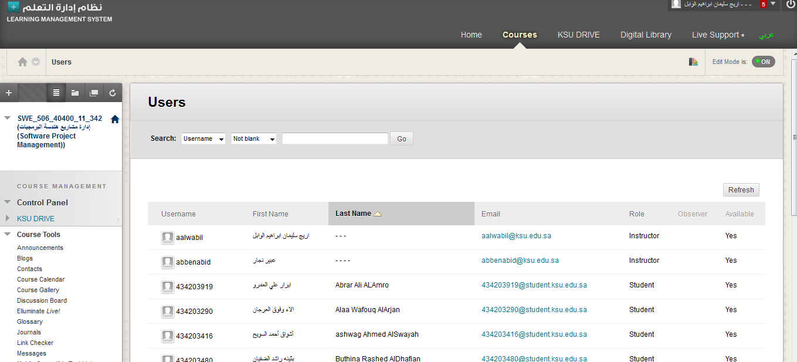
LMS for SWE 434

Slide 15
Grading Schema
Midterm 1 exam | 20%
Lab | 20%
Take Home Assignments (2) | 10%
Class Quizzes (2-3) / Midterm 2 exam | 10%
Final Exam (student should achieve at least 50% of the Final to pass the course) | 40%
Total | 100%

Slide 16
Course Instructions and Policies
Mobiles should be turned off/silent during lectures and tutorials
No makeup exams. Exceptions will be considered with evidence and the approval of the exam committee
Academic dishonesty (plagiarism) is strictly prohibited, and both parties will be penalized
A sharp deadline for project and home works will be applied. Late submission will not be accepted

Slide 17
E-mail Communication
Your email header must start with [SWE434] + your section + your name.
Send your email to yourInstructor@KSU.edu.sa email address.
Send your email from studentID@Student.KSU.edu.sa email address.
Please write your name and your ID at the end of the email.

Slide 18
Welcome Aboard!

